Slide 1


Globsyn finishing school, Globsyn Crystals, 1st Floor, XI – 11 and 12, Block EP, Sector V, Salt Lake, Kolkata – 700091

Slide 2

Startup Funding
GROUP MEMBER’S NAME :
RAHUL ROY,ACADEMY OF TECHNOLOGY,151690110158
JEET SAHA,ACADEMY OF TECHNOLOGY,1516901159
SPANDAN SEN SARMA,ACADEMY OF TECHNOLOGY,1516901181

Slide 3
Table of Contents
Acknowledgement...........................................................................................................4
Project Objective .............................................................................................................5
Requirement Specification ..............................................................................................6
Approach to problem solution..........................................................................................9
Code.................................................................................................................................23
Data Processing and feature selection............................................................................30
Future Scope of Improvements.......................................................................................32

Slide 4
Acknowledgement
I take this opportunity to express my profound gratitude and deep regards to my faculty Mr. Titas Roychowdhury for his exemplary guidance, monitoring and constant encouragement throughout the course of this project. The blessing, help and guidance given by him time to time shall carry me a long way in the journey of life on which I am about to embark.
I am obliged to my project team members for the valuable information provided by them in their respective fields. I am grateful for their cooperation during the period of my assignment.

Slide 5
Project Objective
A startup is a young company that is just beginning to develop. Startups are usually small and initially financed and operated by a handful of founders or one individual. These companies offer a product or service that is not currently being offered elsewhere in the market, or that the founders believe is being offered in an inferior manner.
The corresponding data-set gives us the data over past years, the startup groups who have got the funding,their group name,date,indestryvertical,citylocation,investorname,investmenttype,amount. PRIMARY GOALS - :
How does the funding ecosystem change with time.
Which cities play a major role in funding.
Which industries are favored by investors for funding.
Who are the important investors in the Indian ecosystem.

Slide 6
Requirement Specification(Data Description)
The DATASET is given to us by our respected teacher Titas Roychowdhury .
Description :-
The dataset has the following fields:-
Sno:-
This denotes the serial no. of startup group.
Date :-
This denotes the year of the funding.
startupname :-
This denotes the names of startup group .
citylocaton:-
This denotes the city names where the fundings are done .

Slide 7
Requirement Specification(Data Description)
industryvertical :-
This denotes the field of startup .
investorsname :-
This denotes the investor name .
Investmenttype :-
This denotes the type of investment .
amount :-
This denotes the either startup group eligible or not .

Slide 8
Approach to problem solution
In machine learning and statistics, classification is the problem of identifying to which of a set of categories (sub-populations) a new observation belongs, on the basis of a training set of data containing observations (or instances) whose category membership is known. An example would be assigning a given email into "spam" or "non-spam" classes or assigning a diagnosis to a given patient as described by observed characteristics of the patient (gender, blood pressure, presence or absence of certain symptoms, etc.). Classification is an example of pattern recognition.
In the terminology of machine learning,[1] classification is considered an instance of supervised learning, i.e. learning where a training set of correctly identified observations is available. The corresponding unsupervised procedure is known as clustering, and involves grouping data into categories based on some measure of inherent similarity or distance.
Often, the individual observations are analyzed into a set of quantifiable properties, known variously as explanatory variables or features. These properties may variously be categorical (e.g. "A", "B", "AB" or "O", for blood type), ordinal (e.g. "large", "medium" or "small"), integer-valued (e.g. the number of occurrences of a particular word in an email) or real-valued (e.g. a measurement of blood pressure). Other classifiers work by comparing observations to previous observations by means of a similarity or distance function.

Slide 9
Here we have the types of classification algorithms in Machine Learning:
Linear Classifiers: Logistic Regression, Naive Bayes Classifier
Support Vector Machines
Decision Trees
Boosted Trees
Random Forest
Neural Networks
Nearest Neighbor

Slide 10
Naive Bayes Classifier (Generative Learning Model) :
It is a classification technique based on Bayes’ Theorem with an assumption of independence among predictors. In simple terms, a Naive Bayes classifier assumes that the presence of a particular feature in a class is unrelated to the presence of any other feature. Even if these features depend on each other or upon the existence of the other features, all of these properties independently contribute to the probability. Naive Bayes model is easy to build and particularly useful for very large data sets. Along with simplicity, Naive Bayes is known to outperform even highly sophisticated classification methods.

Slide 11
Naive Bayes Classifier
Naive Bayes is a classification algorithm for binary (two-class) and multi-class classification problems. The technique is easiest to understand when described using binary or categorical input values.
It is called naive Bayes or idiot Bayes because the calculation of the probabilities for each hypothesis are simplified to make their calculation tractable. Rather than attempting to calculate the values of each attribute value P(d1, d2, d3|h), they are assumed to be conditionally independent given the target value and calculated as P(d1|h) * P(d2|H) and so on.
This is a very strong assumption that is most unlikely in real data, i.e. that the attributes do not interact. Nevertheless, the approach performs surprisingly well on data where this assumption does not hold.
Representation Used By Naive Bayes Models
The representation for naive Bayes is probabilities.
A list of probabilities are stored to file for a learned naive Bayes model. This includes:
Class Probabilities: The probabilities of each class in the training dataset.
Conditional Probabilities: The conditional probabilities of each input value given each class value.

Slide 12
Make Predictions With a Gaussian Naive Bayes Model
Probabilities of new x values are calculated using the Gaussian Probability Density Function(PDF).
When making predictions these parameters can be plugged into the Gaussian PDF with a new input for the variable, and in return the Gaussian PDF will provide an estimate of the probability of that new input value for that class.
pdf(x, mean, sd) = (1 / (sqrt(2 * PI) * sd)) * exp(-((x-mean^2)/(2*sd^2)))
Where pdf(x) is the Gaussian PDF, sqrt() is the square root, mean and sd are the mean and standard deviation calculated above, PI is the numerical constant, exp() is the numerical constant e or Euler’s number raised to power and x is the input value for the input variable.
We can then plug in the probabilities into the equation above to make predictions with real-valued inputs.
For example, adapting one of the above calculations with numerical values for weather and car:
go-out = P(pdf(weather)|class=go-out) * P(pdf(car)|class=go-out) * P(class=go-out)

Slide 13
Logistic Regression (Predictive Learning Model) :
It is a statistical method for analysing a data set in which there are one or more independent variables that determine an outcome. The outcome is measured with a dichotomous variable (in which there are only two possible outcomes). The goal of logistic regression is to find the best fitting model to describe the relationship between the dichotomous characteristic of interest (dependent variable = response or outcome variable) and a set of independent (predictor or explanatory) variables.

Slide 14
Dependent variable
The variable whose values you want to predict. The dependent variable must be binary or dichotomous, and should only contain data coded as 0 or 1. If your data are coded differently, you can use the Define status tool to recode your data.
Independent variables
Select the different variables that you expect to influence the dependent variable.
Filter
(Optionally) enter a data filter in order to include only a selected subgroup of cases in the analysis.
Options
Method: select the way independent variables are entered into the model.
Enter: enter all variables in the model in one single step, without checking
Forward: enter significant variables sequentially
Backward: first enter all variables into the model and next remove the non-significant variables sequentially
Stepwise: enter significant variables sequentially; after entering a variable in the model, check and possibly remove variables that became non-significant.
Enter variable if P<
A variable is entered into the model if its associated significance level is less than this P-value.
Remove variable if P>
A able is removed from the model if its associated significance level is greater than this P-value.

Slide 15
Enter variable if P<
A variable is entered into the model if its associated significance level is less than this P-value.
Remove variable if P>
A variable is removed from the model if its associated significance level is greater than this P-value.
Classification table cutoff value: a value between 0 and 1 which will be used as a cutoff value for a classification table. The classification table is a method to evaluate the logistic regression model. In this table the observed values for the dependent outcome and the predicted values (at the selected cut-off value) are cross-classified.
Categorical: click this button to identify nominal categorical variables.
Overall model fit
The null model −2 Log Likelihood is given by −2 * ln(L₀) where L₀ is the likelihood of obtaining the observations if the independent variables had no effect on the outcome.
The full model −2 Log Likelihood is given by −2 * ln(L) where L is the likelihood of obtaining the observations with all independent variables incorporated in the model.
The difference of these two yields a Chi-Squared statistic which is a measure of how well the independent variables affect the outcome or dependent variable.
If the P-value for the overall model fit statistic is less than the conventional 0.05 then there is evidence that at least one of the independent variables contributes to the prediction of the outcome.
Cox & Snell R² and Nagelkerke R² are other goodness of fit measures known as pseudo R-squareds. Note that Cox & Snell's pseudo R-squared has a maximum value that is not 1. Nagelkerke R² adjusts Cox & Snell's so that the range of possible values extends to 1.

Slide 16
Decision Trees:
Decision tree builds classification or regression models in the form of a tree structure. It breaks down a data set into smaller and smaller subsets while at the same time an associated decision tree is incrementally developed. The final result is a tree with decision nodes and leaf nodes. A decision node has two or more branches and a leaf node represents a classification or decision. The topmost decision node in a tree which corresponds to the best predictor called root node. Decision trees can handle both categorical and numerical data.

Slide 17
In the first split or the root, all attributes/features are considered and the training data is divided into groups based on this split. We have 3 features, so will have 3 candidate splits. Now we will calculate how much accuracy each split will cost us, using a function. The split that costs least is chosen, which in our example is sex of the passenger. This algorithm is recursive in nature as the groups formed can be sub-divided using same strategy. Due to this procedure, this algorithm is also known as the greedy algorithm, as we have an excessive desire of lowering the cost. This makes the root node as best predictor/classifier.
Lets say, we are predicting the price of houses. Now the decision tree will start splitting by considering each feature in training data. The mean of responses of the training data inputs of particular group is considered as prediction for that group. The above function is applied to all data points and cost is calculated for all candidate splits. Again the split with lowest cost is chosen.

Slide 18
Nearest Neighbor:
The k-nearest-neighbors algorithm is a classification algorithm, and it is supervised: it takes a bunch of labelled points and uses them to learn how to label other points. To label a new point, it looks at the labelled points closest to that new point (those are its nearest neighbors), and has those neighbors vote, so whichever label the most of the neighbors have is the label for the new point (the “k” is the number of neighbors it checks).

Slide 19
The training examples are vectors in a multidimensional feature space, each with a class label. The training phase of the algorithm consists only of storing the feature vectors and class labels of the training samples.
In the classification phase, k is a user-defined constant, and an unlabeled vector (a query or test point) is classified by assigning the label which is most frequent among the k training samples nearest to that query point.
A commonly used distance metric for continuous variables is Euclidean distance. For discrete variables, such as for text classification, another metric can be used, such as the overlap metric (or Hamming distance). In the context of gene expression microarray data, for example, k-NN has also been employed with correlation coefficients such as Pearson and Spearman.[3] Often, the classification accuracy of k-NN can be improved significantly if the distance metric is learned with specialized algorithms such as Large Margin Nearest Neighbor or Neighbourhood components analysis.
A drawback of the basic "majority voting" classification occurs when the class distribution is skewed. That is, examples of a more frequent class tend to dominate the prediction of the new example, because they tend to be common among the k nearest neighbors due to their large number.[4] One way to overcome this problem is to weight the classification, taking into account the distance from the test point to each of its k nearest neighbors. The class (or value, in regression problems) of each of the k nearest points is multiplied by a weight proportional to the inverse of the distance from that point to the test point. Another way to overcome skew is by abstraction in data representation. For example, in a self-organizing map (SOM), each node is a representative (a center) of a cluster of similar points, regardless of their density in the original training data. K-NN can then be applied to the SOM

Slide 20
Parameter selection
The best choice of k depends upon the data; generally, larger values of k reduces effect of the noise on the classification,[5] but make boundaries between classes less distinct. A good k can be selected by various heuristic techniques (see hyperparameter optimization). The special case where the class is predicted to be the class of the closest training sample (i.e. when k = 1) is called the nearest neighbor algorithm.
The accuracy of the k-NN algorithm can be severely degraded by the presence of noisy or irrelevant features, or if the feature scales are not consistent with their importance. Much research effort has been put into selecting or scaling features to improve classification. A particularly popular[citation needed] approach is the use of evolutionary algorithms to optimize feature scaling.[6] Another popular approach is to scale features by the mutual information of the training data with the training classes.[citation needed]In binary (two class) classification problems, it is helpful to choose k to be an odd number as this avoids tied votes. One popular way of choosing the empirically optimal k in this setting is via bootstrap method.[7]
The 1-nearest neighbor classifier
The most intuitive nearest neighbour type classifier is the one nearest neighbour classifier that assigns a point x to the class of its closest neighbour in the feature space, that is { C_{n}^{1nn}(x)=Y_{(1)}} C_{n}^{{1nn}}(x)=Y_{{(1)}}.As the size of training data set approaches infinity, the one nearest neighbour classifier guarantees an error rate of no worse than twice the Bayes error rate (the minimum achievable error rate given the distribution of the data).

Slide 21
Dimension reduction
For high-dimensional data (e.g., with number of dimensions more than 10) dimension reduction is usually performed prior to applying the k-NN algorithm in order to avoid the effects of the curse of dimensionality.
The curse of dimensionality in the k-NN context basically means that Euclidean distance is unhelpful in high dimensions because all vectors are almost equidistant to the search query vector (imagine multiple points lying more or less on a circle with the query point at the center; the distance from the query to all data points in the search space is almost the same).
Feature extraction and dimension reduction can be combined in one step using principal component analysis (PCA), linear discriminant analysis (LDA), or canonical correlation analysis (CCA) techniques as a pre-processing step, followed by clustering by k-NN on feature vectors in reduced-dimension space. In machine learning this process is also called low-dimensional embedding.[16]For very-high-dimensional datasets (e.g. when performing a similarity search on live video streams, DNA data or high-dimensional time series) running a fast approximate k-NN search using locality sensitive hashing, "random projections", "sketches" or other high-dimensional similarity search techniques from the VLDB toolbox might be the only feasible option
Decision boundary
Nearest neighbor rules in effect implicitly compute the decision boundary. It is also possible to compute the decision boundary explicitly, and to do so efficiently, so that the computational complexity is a function of the boundary complexity.

Slide 22
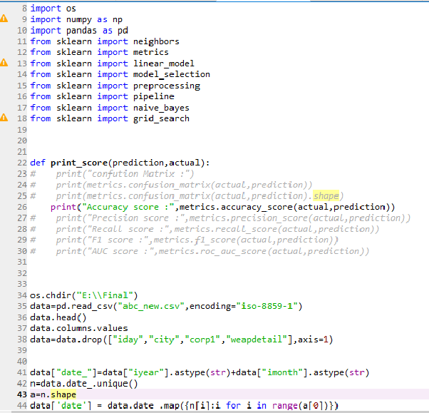
Code

Slide 23
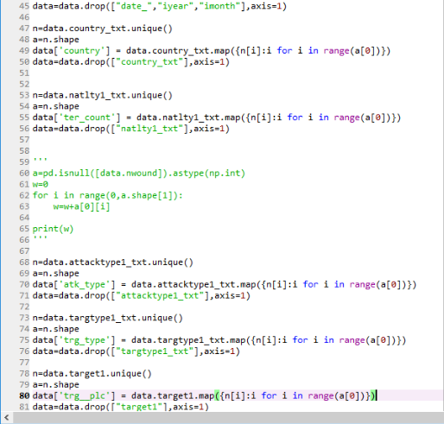
Code

Slide 24
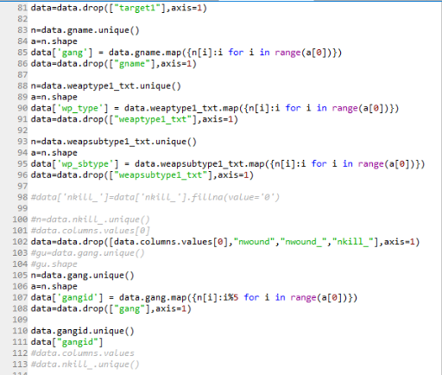
Code

Slide 25
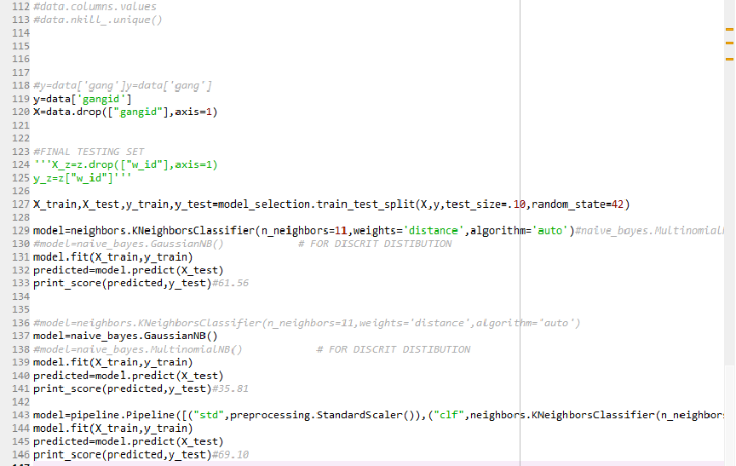
Code

Slide 26
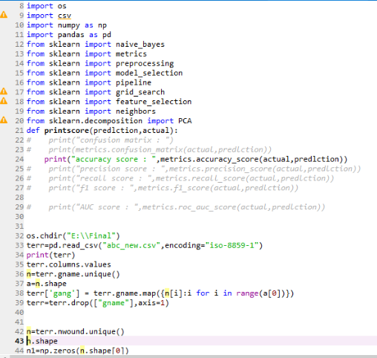
Code

Slide 27
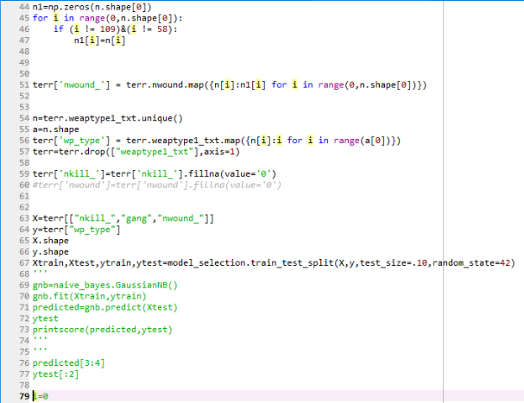
Code

Slide 28
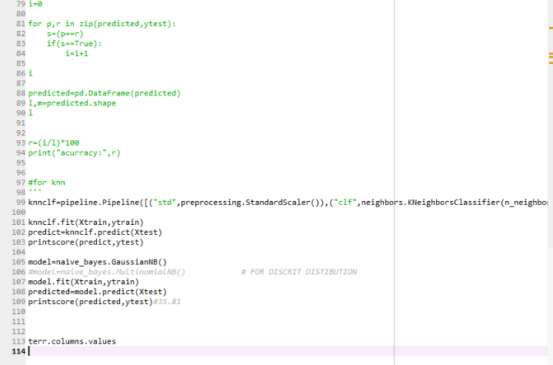
Code

Slide 29
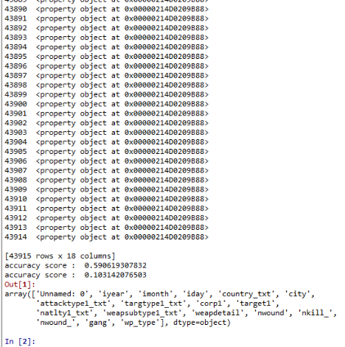
Data processing feature selection

Slide 30
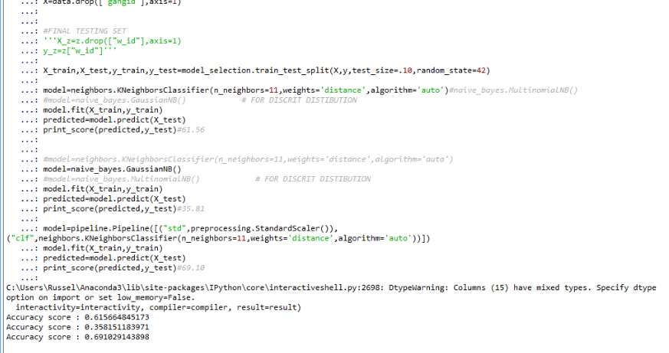
Data processing feature selection

Slide 31
Future Scope of Improvements
In this project with the provided terrorism data. After analyzing the data and applying k-nearest neighbors and naive bayes on our data we found a tends to accuracy.
In future if we can further classify our data and apply different algorithm so if the data accuracy can be refined so it different ways can be forecasted.
terrorist groups can be identified and also we can guess the attack place, attacked countries, hostages captured and also we can prevent different kinds of attacks in our country and also all over the world.
This data-analytics can help out our country in different forms and also this information can be shared to the army for the beneficial things.
hence the future scopes of improvement can be generalized such that if we can decode or data more efficiently and neatly that can help us a lot and makes our work far more easy.

Slide 32
Certificate
This is to certify that Mr. Spandan Sen Sarma of Academy Of Technology, registration number: 151690110181, has successfully completed a project on Global Terrorism using MACHINE LEARNING(Python) under the guidance of
Mr. Titas Roychowdhury.
Mr. Titas Roychowdhury
Globsyn Finishing School

Slide 33
Certificate
This is to certify that Mr. Rahul Roy of Academy Of Technology, registration number: 151690110158, has successfully completed a project on Global Terrorism using MACHINE LEARNING(Python) under the guidance of
Mr. Titas Roychowdhury.
Mr. Titas Roychowdhury
Globsyn Finishing School

